Slide 1


Predict Clicked Ads Customer Classification by using Machine Learning
Created by:
Philipus Dima Wira Pratomo
pwirapratomo@gmail.com
https://www.linkedin.com/in/philipus-dima-wira-pratomo-a221391ab/
Graduated from Pertamina University majoring in petroleum engineering with a GPA of 3.78. Currently I want to shift career to data scientist by attending a data science bootcamp. where I am developing expertise using data visualization tools such as Tableau and Looker Studio, SQL and several Python libraries to create machine learning. My objective is to become a professional data scientist and leverage my skills to contribute to data-driven decision-making in diverse industries.

Slide 2
Overview
"A company in Indonesia wants to know the effectiveness of the advertisement they broadcast. This is important for the company to know how successful the advertisement being marketed is so that it can attract customers to see the advertisement.
"By processing historical advertisement data and finding insights and patterns that occur, it can help companies determine marketing targets. The focus of this case is to create a machine learning classification model that functions to determine the right target customers."

Slide 3
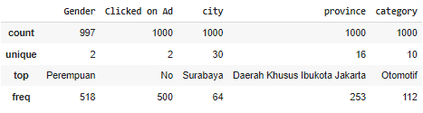
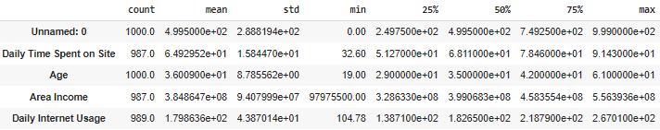
Statistical Analysis
Insight
The contents of all columns are reasonable
The maximum/minimum value is not too far from the mean/median
The mean and median are not too far apart
The contents of each unique value are reasonable
For details, you can see the jupyter notebook here

Slide 4
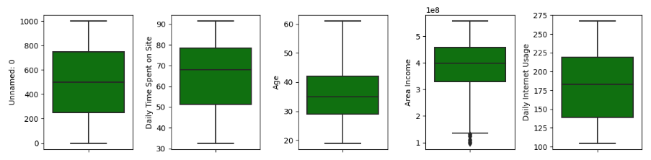
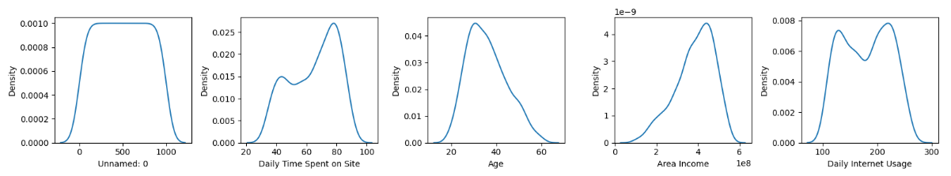
Univariate Analysis - Numerical
Insight
There are outliers in the income feature area
Feature Area Income distribution is slightly Negative Skew
The Daily Time Spent distribution feature includes bimodal distribution
Feature Age distribution is slightly positive Skew
The daily internet usage feature has a normal distribution
Characteristics of customers who click on ads
For details, you can see the jupyter notebook here

Slide 5
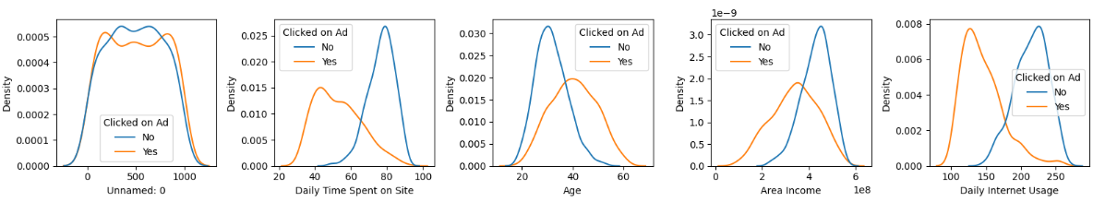
Univariate Analysis - Numerical
Insight
Characteristics of customers who click on ads
Daily Time Spent on site = 40 – 60
Age = 35 – 50
Area Income = 3 – 4
Daily Internet Usage = 120 - 150
Characteristics of customers who don't click on ads
Daily Time Spent on site = 75 - 85
Age = 25 - 35
Area Income = 4 - 5
Daily Internet Usage = 220 – 240
Customers who click on ads tend to spend more daily time on site than those who don't click on ads
Customers who click on ads tend to be older than those who don't click on ads
Customers who click on ads tend to have a lower income area than those who don't click on ads
Customers who click on ads tend to have lower daily internet usage than those who don't click on ads
For details, you can see the jupyter notebook here

Slide 6
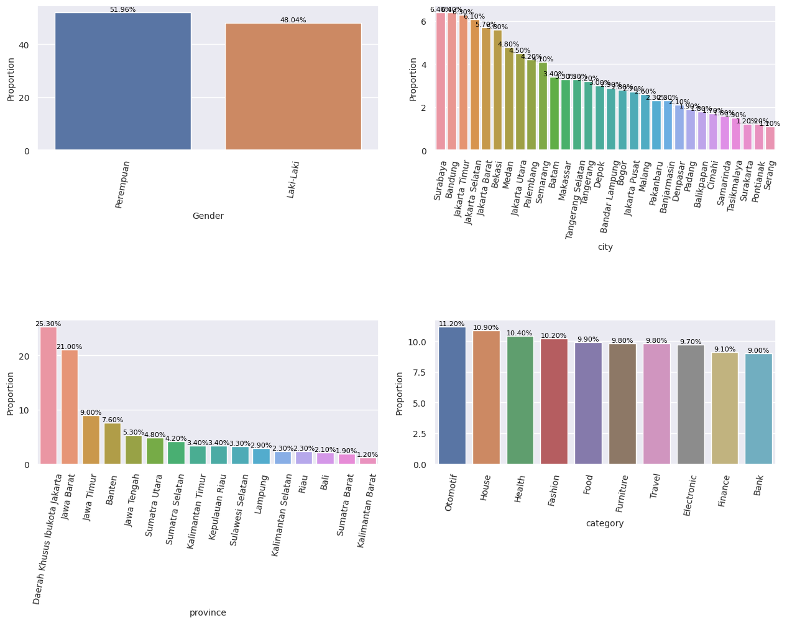
Univariate Analysis - Categorical
Insight
There are more women than men, although not much different
The largest province is DKI Jakarta
Automotive is the highest category, but not much different from other categories
The largest cities are Surabaya and Bandung
For details, you can see the jupyter notebook here

Slide 7
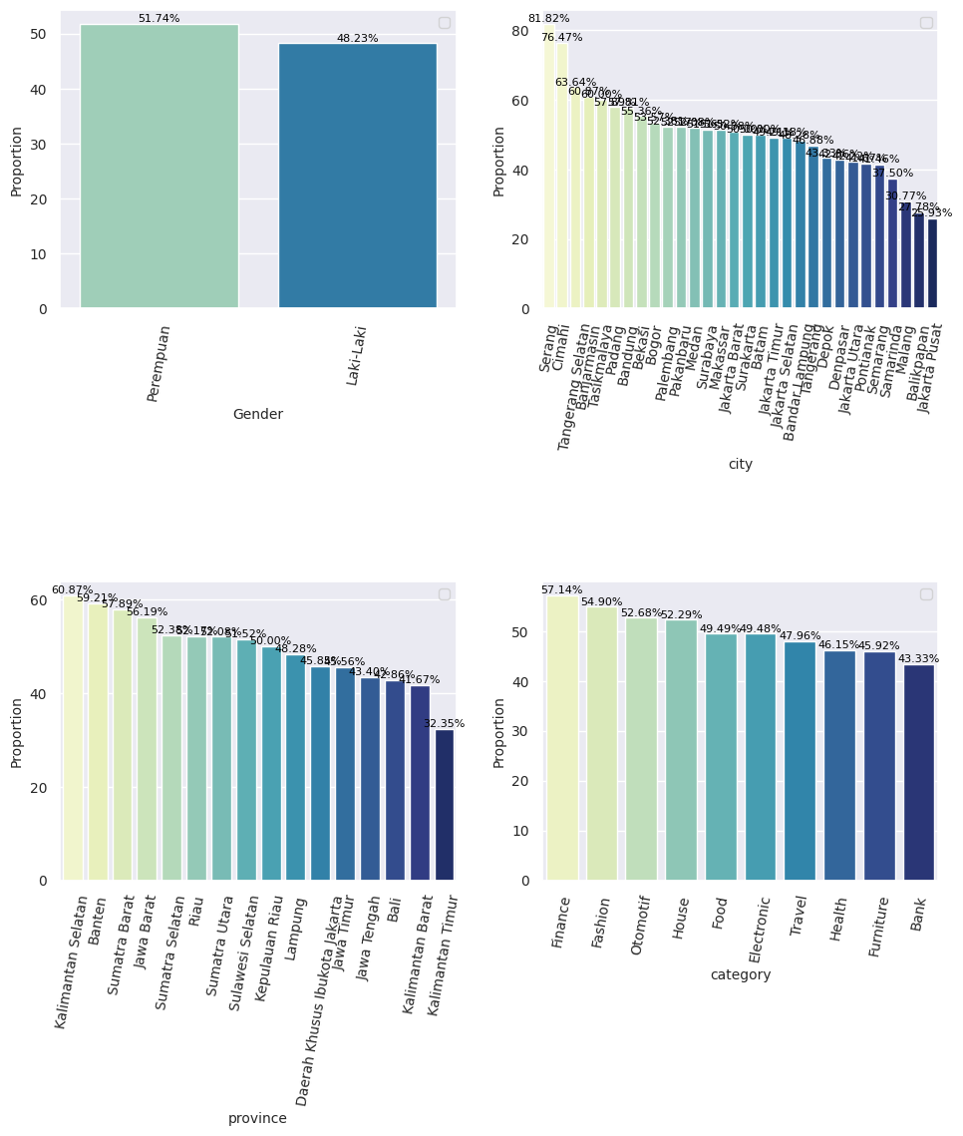
Univariate Analysis - Categorical
Insight
If grouped by gender, women click more on Ads than men
If grouped by city, some cities such as Cimahi and Serang tend to click on ads compared to other cities
If grouped by province, South Kalimantan and Banten tend to click on ads compared to other provinces
If grouped by category, Finance and Fashion tend to click on ads compared to other categories
For details, you can see the jupyter notebook here

Slide 8
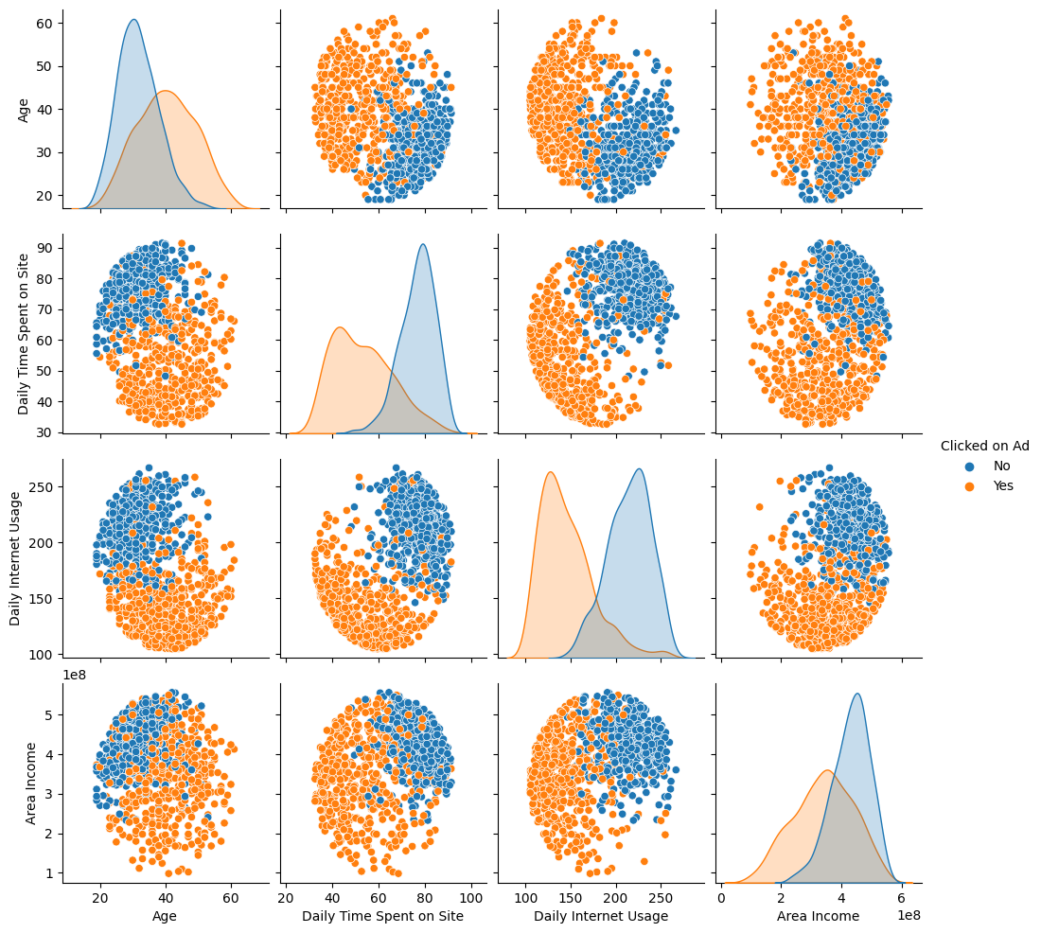
Bivariate Analysis
Insight
Customers who click on ads tend to be more mature with daily time spent on the site, daily internet usage, and low area income
It can be concluded that the longer the customer, the lower the daily time spent on the site, daily internet usage and area income, and vice versa
For details, you can see the jupyter notebook here

Slide 9
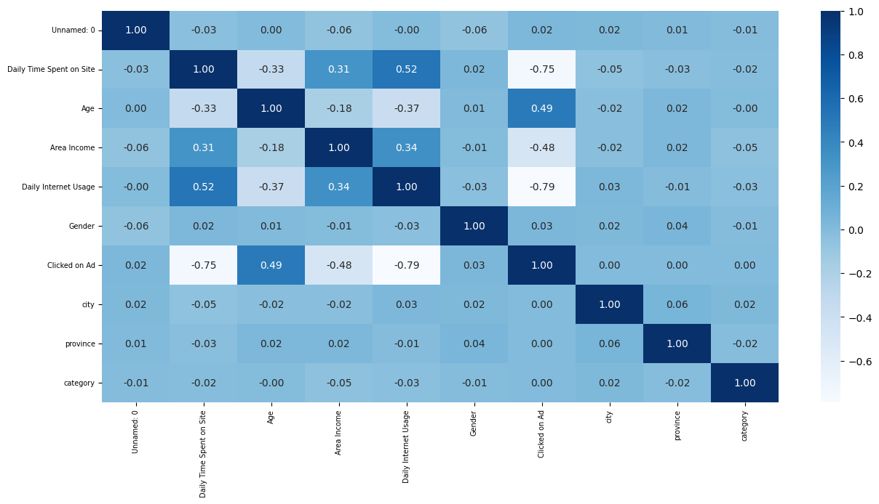
Bivariate Analysis
Insight
There are 4 features that have a high correlation with the target (Clicked on Ad)
Age is negatively correlated with Daily Time Spent, Area Income and Daily Internet Usage. However, it has a positive correlation with the target (Clicked on Ad)
Are Income is positively correlated with Daily Time Spent and Daily Internet Usage. However, it has a negative correlation with the target (Clicked on Ad)
Daily Internet Usage is positively correlated with Daily Time on Site. However, it has a negative correlation with the target (Clicked on Ad)
Daily Time on Site has a negative correlation with the target (Clicked on Ad)
For details, you can see the jupyter notebook here

Slide 10
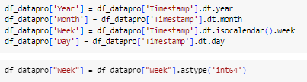
Data Cleaning & Preprocessing
Handling Missing Value
Handling missing values ​​will be carried out on features:
Daily Time Spent on Site, filled in with the median
Area Income, fill in the median
Daily Internet Usage, fill in the median
Gender, filled in with mode
Feature Engineering
Create a new feature from timestamp to year, month, week and day and change week data type into int64
Feature Encoding
Perform One-Hot Encoding for the "Gender" feature and replace "1" with "Yes" and "0" with "No" in the "Clicked on Ad" feature.
For details, you can see the jupyter notebook here

Slide 11
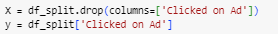

Data Cleaning & Preprocessing
Delete Unnecessary Feature
Delete the following features: "Unnamed Features: 0" since it doesn't provide any information, "year" as it contains only one unique value, "Timestamp" because feature engineering has already been performed, and "city," "province," and "category" due to the high number of unique values which would lead to the curse of dimensionality when one-hot encoding is applied.
Split Data into X (Feature) and y (Target)
Split Data Train dan Data Test
Split with 70% Data Training and 30% Data Testing
For details, you can see the jupyter notebook here

Slide 12
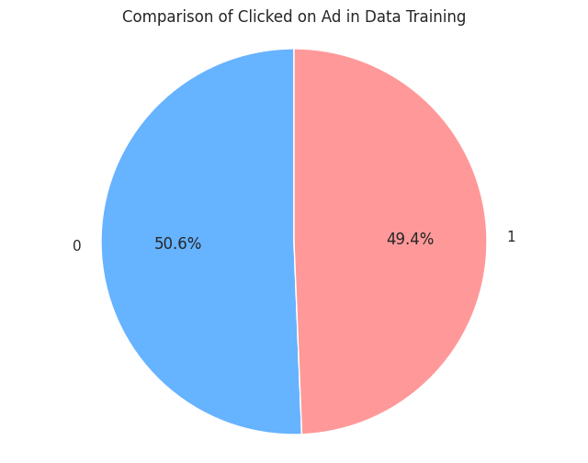
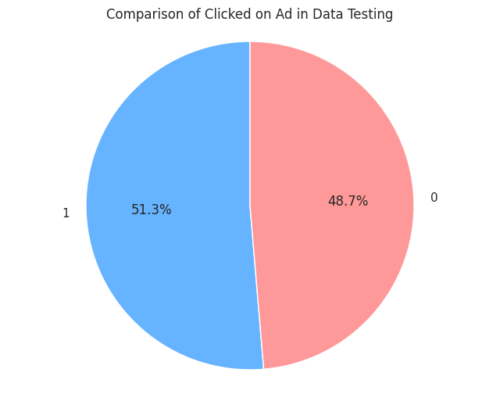
Data Cleaning & Preprocessing
Handling Outlier
Outliers will be removed in the Income Area in Data Train using Z-Scores
Before = 700 data
After = 699 data
Handling Outlier
Data Training and Data Test has Class Balanced
For details, you can see the jupyter notebook here

Slide 13
Metrics Evaluation
The chosen evaluation metric is Recall, which the goals to reduce False Negative (Predict No actually they click the Ads), because the main is to maximizing the number of customers who genuinely click on the ad to enhance the effectiveness of advertising delivery.
For details, you can see the jupyter notebook here

Slide 14
Data Modeling
Experiment
Experiment 1: Modeling without Normalization/Standardization
Experiment 2: Modeling with Normalization/Standardization
For details, you can see the jupyter notebook here

Slide 15
Experiment 1: Modeling without Normalization/Standardization
INSIGHTS
From the overall analysis of the models and evaluation matrices, it is evident that there is a significant gap between the training and test data, indicating the presence of overfitting.
In the initial experiments, it is observed that Gradient Boosting and Random Forest exhibit strong recall performance.
SVM, on the other hand, demonstrates the lowest recall when compared to the other models.
For details, you can see the jupyter notebook here

Slide 16
Experiment 2: Modeling with Normalization/Standardization
INSIGHTS
After standardization, it's evident that certain features, such as 'Daily Time Spent on Site,' 'Daily Internet Usage,' 'Area Income,' and 'Age,' have led to improved evaluation matrix scores for SVM and KNN.
For Gradient Boosting, Random Forest, Decision Tree, and XGBoost, standardization seems to have a minimal impact on the evaluation matrix scores.
In the second round of experiments, it is apparent that Gradient Boosting and Random Forest continue to exhibit strong recall performance.
Consequently, Random Forest is selected as the best-performing model.
The gap between the training and test data is still somewhat wide, indicating the need for hyperparameter tuning to prevent overfitting.
For details, you can see the jupyter notebook here

Slide 17
Selected Model
Among the various machine learning models that have been explored, Random Forest has been selected as the top-performing model. Following this, hyperparameter tuning will be conducted after standardization to mitigate the risk of overfitting. The table besides show the Evaluation Matrix after doing hyperparameter tuning.
For details, you can see the jupyter notebook here

Slide 18
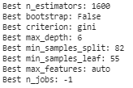
Hyperparameter Tuning
Using RandomizedSearchCV, table besides show the best hyperparameter tuning
For details, you can see the jupyter notebook here

Slide 19
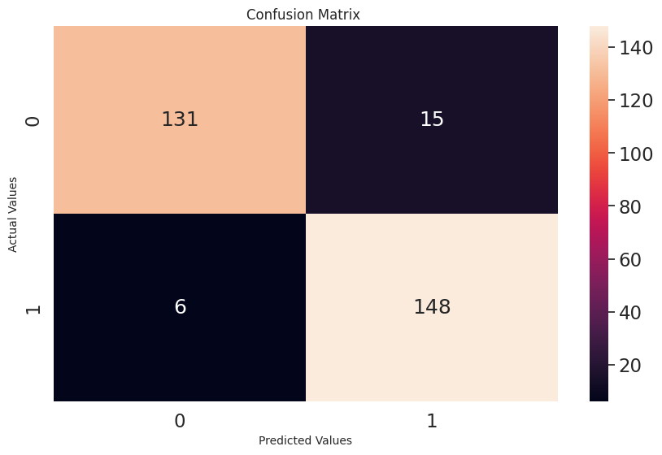
Confusion Matrix for Best Model (Random Forest)
As mentioned earlier with a focus on recall, from the confusion matrix, it is apparent that the number of False Negatives (Predictive no actual they click the ads) has been significantly reduced, aligning with the previously provided Evaluation Matrix table where the Recall was at 96%.
For details, you can see the jupyter notebook here

Slide 20
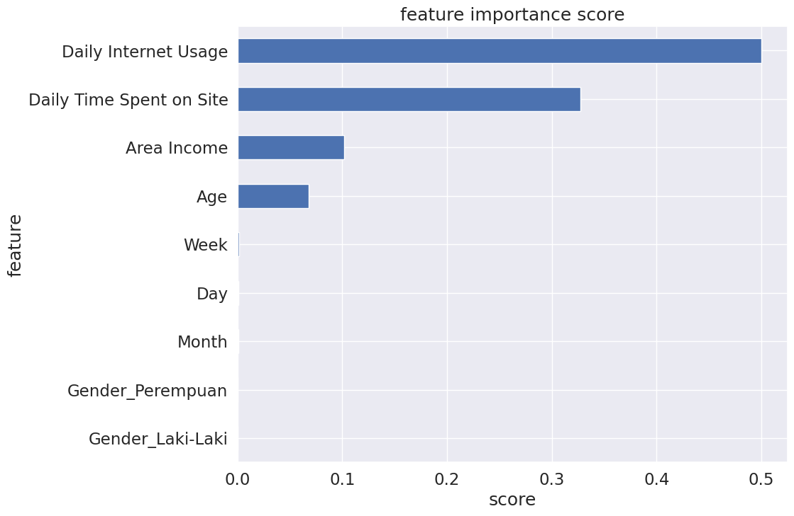
Feature Importance
After determining the best model and conducting hyperparameter tuning, a feature importance analysis was performed. As depicted in the Feature Important Score graph, it is evident that Daily Internet Usage and Daily Time Spent on Site emerge as the top two most crucial features for optimizing marketing success
For details, you can see the jupyter notebook here

Slide 21
Business Recommendation
Enhance Ad Relevance for Customer Loyalty: Customers who click on ads tend to spend more daily time on the site, indicating their interest. Tailor ads with more relevant and engaging content to boost customer loyalty.
Age-Driven Segmentation: If older customers are more likely to click on ads, adapt ads to attract this demographic. Offer products and promotions tailored to their preferences and needs.
Income-Based Ad Offers: Focus on optimizing ads for lower-income areas where customers tend to click more. Offer affordable products and services to align with their spending capacity.
Target More Mature Audience: Develop advanced ad strategies for mature customers who spend more time on the site, have lower daily internet usage, and reside in low-income areas. Consider premium or exclusive offers for this segment.
Adapt Ads to Popular Categories: Optimize ads in categories like Finance and Fashion, which receive more clicks. Offer specialized products or promotions that resonate with customer interests in these categories.
Engage Low Daily Internet Users: Create captivating ads for customers with lower daily internet usage. Focus on offline or simpler device-centric offers to cater to their preferences.
For details, you can see the jupyter notebook here

Slide 22
Business Simulation
Assumption :
Budget to post Ads : 5,000
The revenue generated by each user clicking : 10,000
there are 1000 people who receive Ads
Before :
Convertion Rate
50%
Total Budget : 5,000,000
Total Revenue : 5,000,000
Total Profit : 0
INCREASE TOTAL PROFIT SIGNIFICANTLY
After :
Convertion Rate
96%
Total Budget : 5,000,000
Total Revenue : 9,600,000
Total Profit : 4,600,000
Machine Learning can work well to increase revenue which in turn increases Ads Marketing efficiency
For details, you can see the jupyter notebook here

